Slide 1
Long Island Population Health Improvement Project (LIPHIP)
February 11, 2016

Slide 2
Health Literacy and Effective Communication for Health Professionals

Slide 3
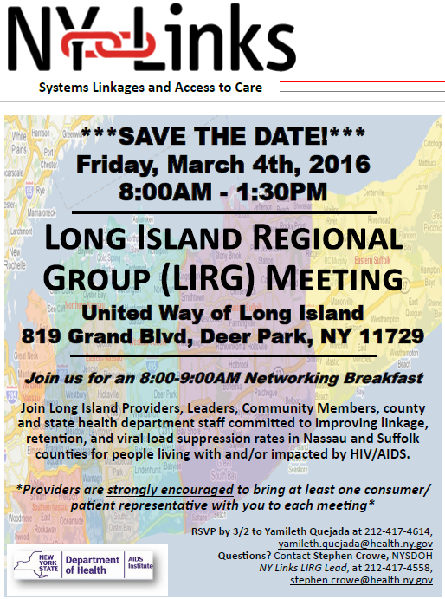
Long Island Regional Group (LIRG)
Friday, March 4th, 2016
United Way of LI
RSVP by 3/2 to Yamileth Quejada yamileth.quejada@health.ny.gov

Slide 4
LIHC/PHIP Updates
Academic Partners
Plan to engage medical schools/students
PHIP Public Health Intern Academic Project
Revision to Survey

Slide 5
LIHC/PHIP Updates
Working Documents
Strategic Plan

Slide 6
LIHC/PHIP Updates
Public Education, Outreach & Community Engagement
Website re-launch
Are You Ready Feet launch
National Walking Day-April 6, 2016
Parks RX Program
LIHC Welcome Brochures
Rack Card for Consumer Promotion

Slide 7
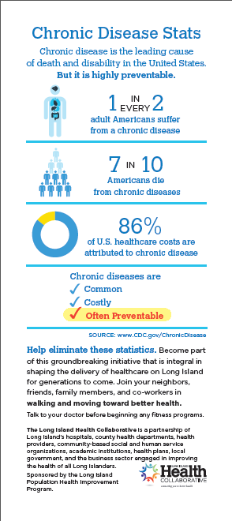
Consumer facing Promotion Tool

Slide 8
Association for Mental Health & Wellness: First Aid Training
Registration now closed/full
Potential for future trainings

Slide 9
LIHC/PHIP Updates
Culturally and Linguistically Appropriate Services – CLAS Train the Trainer Sessions
Meeting February 19, 2016

Slide 10
Data Updates
Wellness Portal: Complementary Training Session
Data Workgroup 2-5-16 Meeting Update

Slide 11
Community Needs Assessments
Prevention Agenda Survey for Community Members
Please return paper surveys to Nassau-Suffolk Hospital Council immediately
Zip Code level analysis to take place before end of month
Nassau-Suffolk Hospital Council Enrollers

Slide 12
CBO Summit Event Update
Nassau County CBO Summit Event –Adelphi University 2/2/16
Suffolk County CBO Summit Event- St. Joseph’s College 2/10/16
Qualitative Data Analysis and Final Report

Slide 13
Walk With Ease Program Arthritis Foundation
Evidence-based program
EAC Inc. partnership
Nassau County Organizations
Program at Eisenhower Park

Slide 14
Population Health Improvement Program
State Budget Update
Briefing for Legislators

Slide 15
Grant Opportunity: CMS Accountable Health Communities
Overview: Address the gap between clinical care and community services in the current delivery system.
Focus Areas: Housing instability and quality, Food insecurity, Utility Needs, Interpersonal Violence, Transportation needs beyond medical transportation

Slide 16
Grant Opportunity Cont’d
Track 1 Interventions:
Inventory of local community services responsive to community needs assessment
Universal Screening of Medicare and Medicaid beneficiaries
Referral to community services for beneficiaries with unmet health-related needs

Slide 17
Grant Opportunity Cont’d
Evaluation:
Test the impact of the AHC interventions on total health care costs and inpatient and outpatient health care utilization, as well as health and quality of care for Medicare and Medicaid beneficiaries.
Letter of Intent-not required: 2/8/16
Application: 3/31/16

Slide 18
Questions/Feedback?

Slide 19
Upcoming Meetings
March 17, 2016 9:30-11:30am
April 20, 2016 2:30-4:30pm
May 18, 2016 9:30-11:30am

